Slide 1
Single Board Computers For Space: The Next Evolutionary Step
Bryan Taylor
Director of Business Development, Aerospace and Defense
Avalanche Technology
MAPLD 2025

Slide 2
PART 1
Avalanche DARPA Connection
PART 2
Avalanche Roadmap
AGENDA
PART 3
Enabled Platforms - Booting
PART 4
Enabled Platforms - Storage
PART 5
Enabled Platforms - Processing

Slide 3
DR. YIMING HUAI
Avalanche CTO /
VP of Technology
1996 - 2002
AVALANCHE’S DARPA CONNECTION
2002 - 2008
2008 - present
Co-Founder, board member, CTO & VP of Engof Grandis, a pioneer in Spin Transfer Torque MRAM (STT-MRAM).
Raised >$30M in private & government funding for STT MRAM.
Has come full circle as Program Manager since $14.7M gov’t funding from a DARPA program led by Dr. Dev Shenoy in 2008.
Joined Avalanche to build highly reliable dual use (industrial/space) MRAMs.
All Avalanche execs are semiconductor industry veterans: https://www.avalanche-technology.com/company/leadership/
Avalanche Technology - Confidential

Slide 4
PART 1
Avalanche DARPA Connection
PART 2
Avalanche Roadmap
AGENDA
PART 3
Enabled Platforms - Booting
PART 4
Enabled Platforms - Storage
PART 5
Enabled Platforms - Processing
Avalanche Technology - Confidential

Slide 5
A Comprehensive Roadmap Highlighting The Current Gen 3 MRAMs
Gen 2
Gen 3
Parallel
High Performance Non-Volatile Working Memory for Advanced Systems
Serial (Boot)
Small Boot/MCM + Scaling Density for Multi-Mission
Boot & Unified Memory
Processing
Leveraging Flight Heritage of Parallel MRAM Technology & Optimizing Interface
2020
2021
2022
2023
2024
2025
2026+
Preproduction
Production
Development
Planned
Avalanche Technology - Confidential
‹#›

Slide 6
Avalanche Family of Gen3 MRAM Devices
Parallel MRAMs
15mm
10mm
10mm
~1.5mm
17mm
64Mb QSPI
Dual QSPI MRAMs
20mm
20mm
128Mb Dual QSPI
Dual QSPI “-A/-E” MRAMs
20mm
-A/-E has higher:
TID & SEE
Performance
An Extended SOA
20mm
Avalanche Technology - Confidential

Slide 7
With Volume Comes Reliability (as of April 2025)
Total MRAM Devices Shipped: 1,550,738
Total MRAM Terabits Shipped: 34.004 Tbits
Industrial
Space Grade
Industrial Devices
Space Grade Devices
12,995
1,537,743
IIndustrial Terabits
15.225 Tbits
Space Grade Terabits
18.779 Tbits
To put this in perspective:
it takes 307,764 x 64Mb Legacy MRAMs
to store 18.8 Tbits
Avalanche Technology - Confidential

Slide 8
Powered by Avalanche – MRAM Device Ecosystem
Industrial
Space Grade
Space Grade, QED, PEMS, QML, and RadHard; 30-year Hi-Rel Qual Heritage Plastic, Die, Hermetic, & MCM
Space Grade, QED, & PEMS L1, L2, L3, 30-year A&D Heritage
Space Grade, QED, PEMS, and RadHard, Standard & Custom 30-year Qual Heritage
Avalanche Technology - Confidential
‹#›

Slide 9
PART 1
Avalanche DARPA Connection
PART 2
Avalanche Roadmap
AGENDA
PART 3
Enabled Platforms - Booting
PART 4
Enabled Platforms - Storage
PART 5
Enabled Platforms - Processing
Avalanche Technology - Confidential

Slide 10
Hi-Rel Boot Requirements Are Only Increasing:
64Mb to ~1Gb Per Image
Vendor
Device
AMD / Xilinx
Virtex-4QV-XQR4V
Higher Density ROMs Required
Virtex-5QV-XQR5V
Full PetaLinux, including User Apps
RT KintexUltraScale XQRKU060
Large FPGSa/MPSoCs
ZynQ UltraScale+
UltraScale, UltraScale+, Versal, MPSoC, CertusPro, Polarfire, etc.
Versal-XQRV
Microchip
RT Polarfile RTPF500T-1CB1509
Configuration Memory Data Integrity
from start until end of mission
Lattice
CertusPro
Data Retention
Non-Volatile
SEL Immunity
SEU Immunity
High Endurance
Frontgrade
CertusPro RT UTC24CP1008
SoC UT32M0R500
Gaisler GR716B
Vorago
ARM-M4-VA41629
Avalanche Technology - Confidential

Slide 11
Phase 1: Reliable Booting for Vorago ARM-M4 Series Family SoCs
VA41630
RH ARM M4 MCU
Config Bitstream
Welcome,
Serial I/F
VA 7230
RT Edge Processing MPU
Welcome,
Avalanche Technology - Confidential

Slide 12
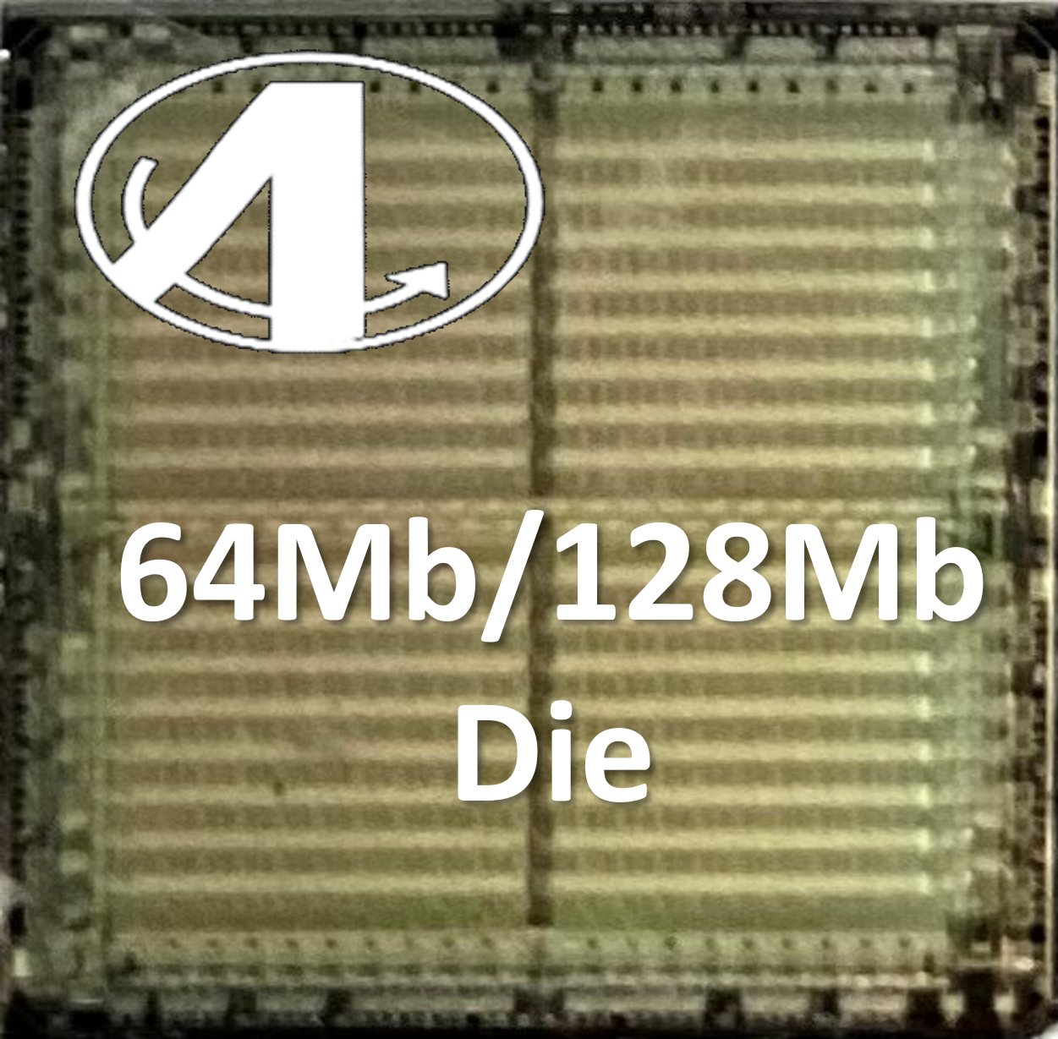
Phase 2: Reliable SiP for Vorago ARM-M4 Series Family SoCs
VA41630
VA 7230
RH ARM M4 MCU
RT Edge Processing MPU
Welcome,
Avalanche Technology - Confidential

Slide 13
Phase 1: Enabling Booting for Lattice CertusPro FPGA
VA41630
RH ARM M4 MCU
Config Bitstream
Serial
Avalanche Technology - Confidential

Slide 14
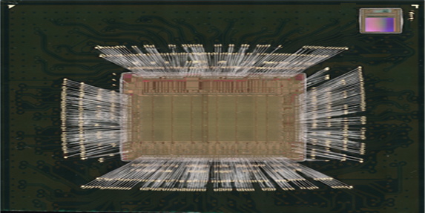
Phase 1: Enabling Hi-Rel Booting for Lattice CertusPro FPGA
Embedded FLASH Die
Embedded MRAM Die
Certus Pro NX Die
Certus Pro NX Die
Avalanche Technology - Confidential
14

Slide 15
Phase 1: Enabling Booting For Gaisler GR716 LEON3FT Processor
VA 7230
RT Edge Processing MPU
Config
Bitstream
Welcome,
Gaisler
GR716B
LEON3FT
Microcontroller
Serial
Welcome,
Avalanche Technology - Confidential

Slide 16
Phase 2: Embedding Booting & Working for Gaisler GR716 LEON3FT Processor
Configuration And Working Memory As SIP
Gaisler
GR716B
LEON3FT
Microcontroller
Avalanche Technology - Confidential
‹#›
17

Slide 17
PART 1
Avalanche DARPA Connection
PART 2
Avalanche Roadmap
AGENDA
PART 3
Enabled Platforms - Booting
PART 4
Enabled Platforms - Storage
PART 5
Enabled Platforms - Processing
Avalanche Technology - Confidential

Slide 18
Reference Designs For Space Drives Nnd Aerospace Data Loggers
On track to launch full Avalanche product suite in 2025
Avionics & Space Grade Storage Class Products
Reference Designs
16Gb MRAM Single Chip
To further enable the community, Avalanche has created reference designs for Space Drives & Aerospace Data Loggers, available as dev kits.
Standard M.2 module available as evaluation card & as reference design.
Welcome,
M-Drive
M.2 64Gb (8Gbyte) MRAM Module
EM configuration uses standard M.2 connector
Ruggedized modules use BGA mounting style
Shipped to Customer
Welcome,
Avalanche Technology - Confidential

Slide 19
New Storage Roadmap With Partners
Scanning satellites in LEO need databuffers.
Communication Satellites in MEO need Hybrid drives
VNX-Plus Data Buffer for LEO Satellites (8GB MRAM)
3U VPX Hybrid Data Storage (32Gb MRAM/1TB NAND)
To further enable the community, Avalanche will provide the VNX-Plus Databuffer & make the Hybrid Data Storage Drive available via partner programs.
Welcome,
12mm/19mm
3.5”/89mm
3.07”/78mm
Avalanche Technology - Confidential

Slide 20
PART 1
Avalanche DARPA Connection
PART 2
Avalanche Roadmap
AGENDA
PART 3
Enabled Platforms - Booting
PART 4
Enabled Platforms - Storage
PART 5
Enabled Platforms - Processing
Avalanche Technology - Confidential

Slide 21
Popular Hi-Rel/Space Processors
All use DDRx DRAM Memory as Processing Memory
Avalanche MRAM’s “Instant ON” capability would make an ideal choice
Welcome,
Welcome,
Avalanche Technology - Confidential

Slide 22
8Gb DDRx Persistent DRAM DIMM for Standard Development Kits
Welcome,
Target Development Systems
AMD/Xilinx Versal (VCK190)
AMD/Xilinx KU060 (ZCU106)
Lattice/Frontgrade CertusPro-RT
Lattice/Frontgrade Avant-X-RT
Boot
DDR4 DRAM Socket
Note: 8Gb P-DRAM DIMM is for Development Purposes
Welcome,

Slide 23
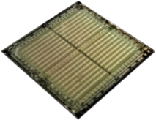
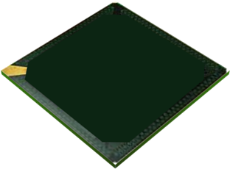
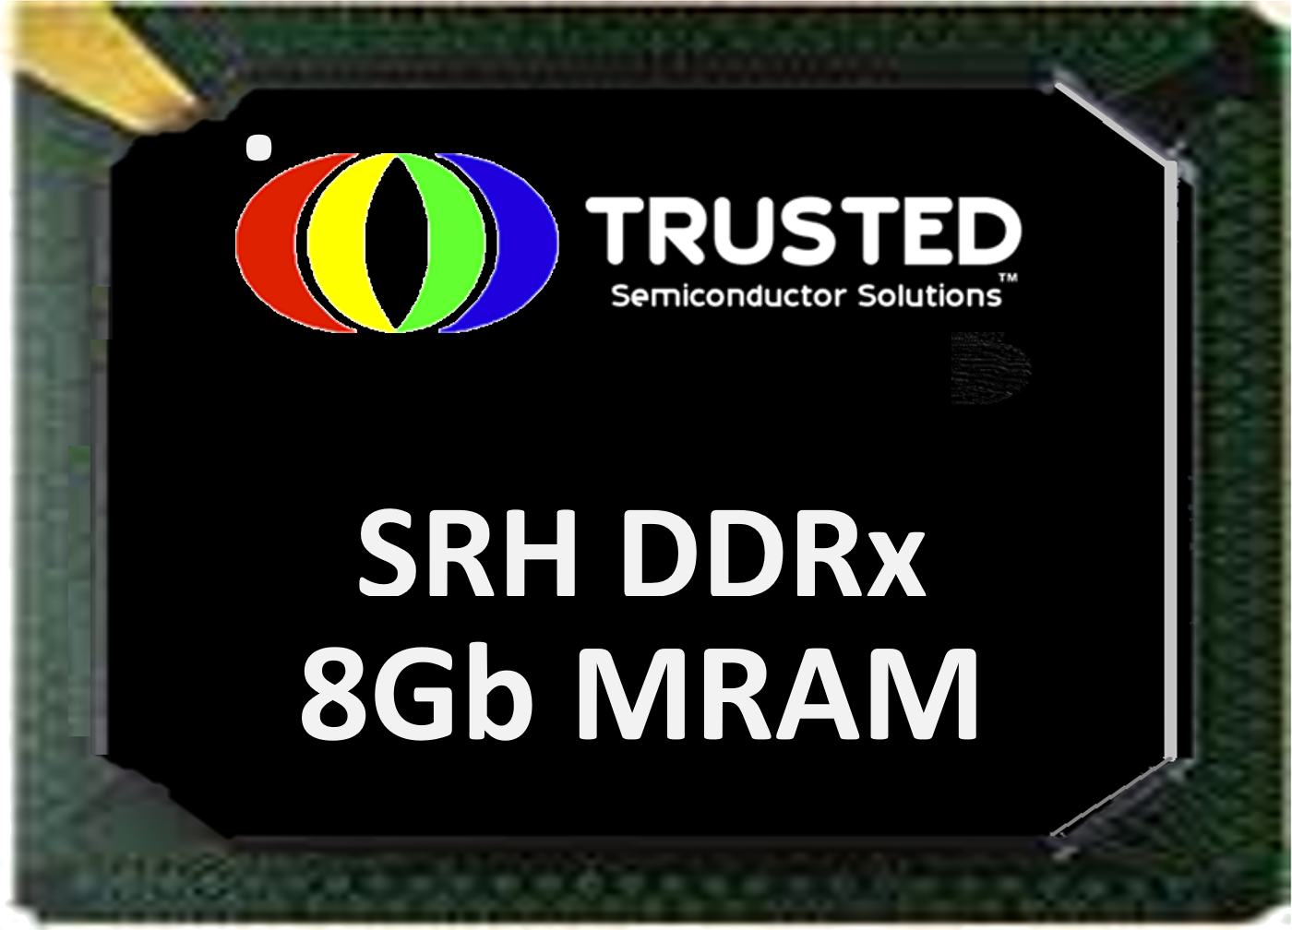
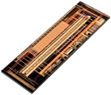
Trusted Semiconductor | SRH High-Density MRAM
2Gb
x4
2Gb
x4
“Avalanche partners with Trusted Semiconductor to develop DDR3/4 non-volatile memory products for aerospace & defense, hardened to Strategic levels
The new product family aims to address demand for radiation-resilient, high-reliability execution memory with instant-on capabilities for strategic environments.
Avalanche plans to release an 8Gb DDR4 DRAM replacement for execution memory in space applications by mid-2025, featuring:
Built-in EDAC for multibit error correction
Non-volatile data storage upon write
Near-infinite write cycle endurance.
SEFI-free performance without shielding
Low power consumption
TSS will create a custom interface chiplet to enhance operation & survivability in challenging radiation environments.”
2Gb x 4
DDRx
Interface Chiplet
SRH DDRx
Interface Chiplet
Welcome,
Note: 8Gb SRH P-DRAM DIMM is for Development Purposes

Slide 24
BOOT
DEVICES
Avalanche Defines
The Next Generation
Of Computing In Space
HI-REL
STORAGE
PROCESSOR MEMORY
Avalanche Technology - Confidential

